Slide 1
Empowering PEOPLE TO NEGOTIATE A BETTER AUTO LOAN
NICKLAS ANKARSTAD

Slide 2
Introduction TO THE PROBLEM
A major concern for lenders is being left out of the conversation when a potential borrower talks to an auto dealer. If lenders could be a part of the conversation the customers is having at the dealership, they could potentially help the customer by providing a lower cost service in the form of lower interest rate or lower payments. The problem is knowing when a person is actually at a car dealership.
In many cases the car-dealers are offering the person who is buying a car a loan and many insurance policies that are significantly marked-up. By enabling financial institutions to understand when someone is at a car dealership, they are able to help reduce the borrowers total cost of ownership a lot and gives them a better negotiating position with the dealer.

Slide 3
The Data
As a prototype, Foursquare location data will be used for the Chicago area. Using this information with some coordinate data, we will calculate the distance from the dealership and create a flag whether or not we believe this individual is at a car dealership.
We will also use data from a local csv file with examples of people, their location coordinates (longitude and latitude) and their email addresses.
Four Square Data
Location Data
People at the dealer

Slide 4
Methodology
We will use the foursquare data to gather auto dealership data. We will get a flat files (csv) with people data. In a commercial setting this could potentially come from the company's web development teams. If the company has a mobile app, they may already be capturing this information. We will use the flat file as a prototype.
Using the foursquare auto dealership data and the geopy library we will calculate the distance between each person's location and the dealership list. Anyone who is 100 feet away from the coordinates of the dealership will be included on our list being at the dealership.

Slide 5
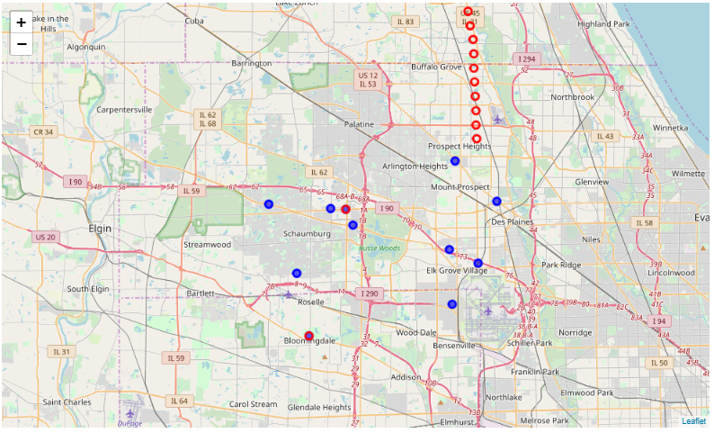
Results
Two individuals were located at a car dealership. This is illustrated on the map . The red circles is the location of the people while the blue dots are the location of the auto dealerships.
We can see that two red circles overlap the blue dots and as such tell us that these people are at a dealership.

Slide 6
Discussion
This has been a prototype to illustrate how using geo-location and foursquare API can help determine whether someone is at a car dealership or not. A couple of items to consider if this were to be productionalized:
Foursquare only allows 50 results to returned - may need to build internal database from pulls or switch developer account
Used For loop which can be inefficient when scaling on large datasets - may need to use vectorization to improve performance
The people file was a clean csv file - may not be the case in commercial application
T hese issues would need to be addressed before promoting to production.

Slide 7
Conclusion
By using the Foursquare API with some filters, we are able to identify the auto dealerships in an area. With a second list of people and their location, we can use python and the geopy library to calculate the distance from the dealership and subsequently target them for an auto loan or insurance product.
This methodology can be applied to any marketing situation where being timely and when the location of an individual can tell what product they are looking to buy.
For the consumer, this allows them to have options in their hand when they are shopping. Often we do not know all the hidden costs and our comparison is more on the primary product we want to purchase (car in this case) and less on ancillary products that comes with that purchase (loan and insurance products).

